Slide 1


Cardiovascular Diseases
Prediction
Group C

Slide 2
Agenda
Project Timeline
Project Roadmap
Coding Standards
Challenges Faced and Resolutions
Analysis and Insights
Dashboard

Slide 3
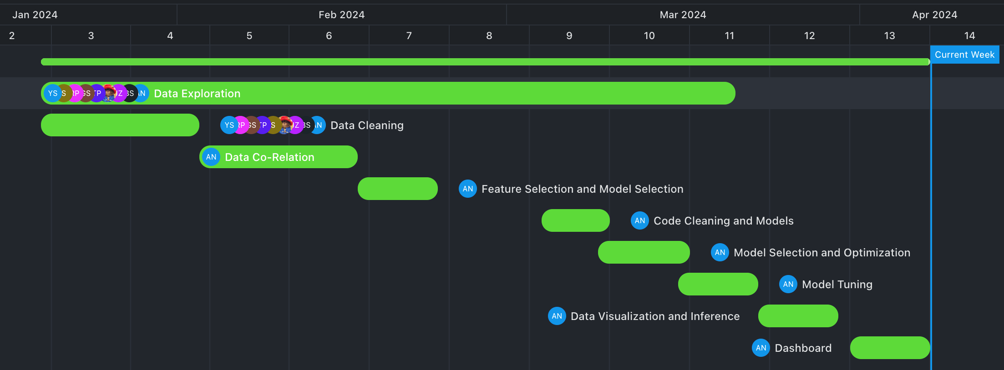
Project Timeline

Slide 4

Project Roadmap
Data Preprocessing
1
Data collection and Cleaning.
Data Consistency and Splitting.
2
Data Exploration
Univariate analysis for distribution and outliers.
Bivariate analysis to uncover relationships.
Feature Engineering
3
One-Hot Encoding
Data Scaling
Feature Extraction
4
Models and Metrics
Logistic Regression, Random Forest and Boosting Classifiers
Metrics: Accuracy, Precision, Recall, F1 Score, ROC-AUC.

Slide 5
Model Tuning and Dumping
5
Random Search CV
LIME
Joblib for dumping
6
Analysis and Insights
Model Performance Metrics
Feature Important Analysis
Dashboard/UI

Slide 6




Coding Standards
Virtual Environment
PEP 8 Standard
Modularization
Keep project dependency separate
Makes sure the project runs the same on different machine
Guideline for coding styling and formatting
Enhance code readability and formatting
Breaks code into reusable component
Class and Function based
Clear to understand and collaborate
Notes:
PEP stands for Python Enhancement Proposal 8

Slide 7
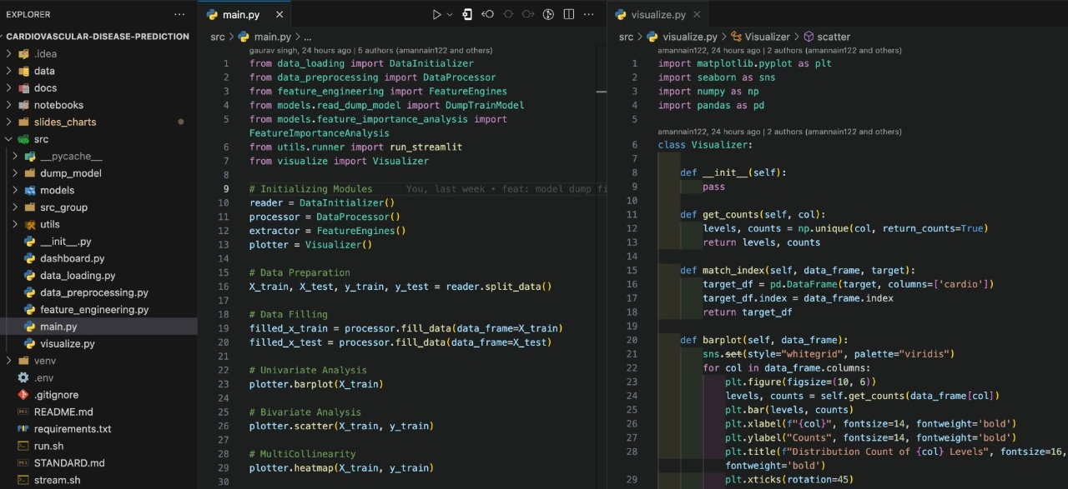

Slide 8

Challenges Faced
1
Data Collection
Large Amount of Data
Legit Data Sources
2
Model Selection
Computation Speed
Strong Metrics
3
Model Tuning
Make Generalized Model
Higher Score on Required Metric

Slide 9
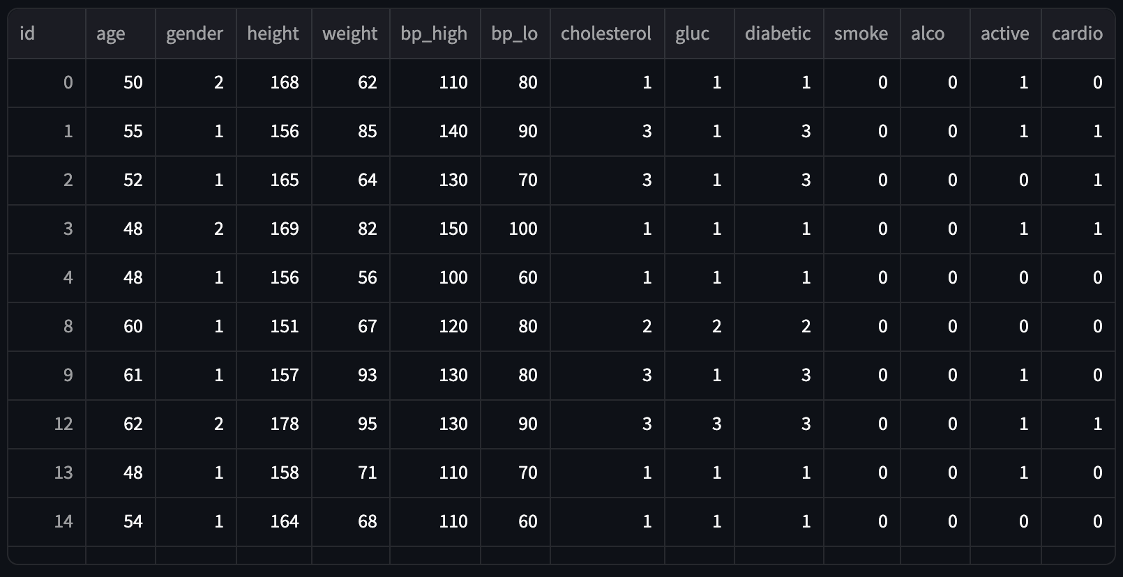
How did we Overcome?
Data Collection
Research to identify and validate reliable data sources
Discussion with Health Professional about data accuracy
And we found the correct data:
https://www.kaggle.com/datasets/sulianova/cardiovascular-disease-dataset/discussion

Slide 10
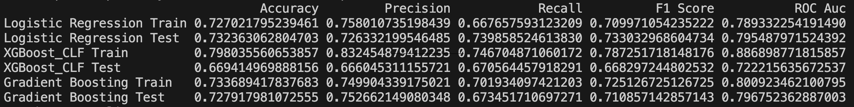
Model Selection and Metrics
Utilized benchmarking and profiling to identify the most computationally efficient models.
Evaluate models against specific performance
Found Boosting Classifiers performed better against unscaled data and larger datasets
Selected XGBoost for higher interpretability with feature importance scores

Slide 11

Model Tuning
Iteratively refined parameters for better metrics
Duplication of the data.
Employed cross-validation techniques like Random SearchCV for generalization
Implemented LIME for checking wrongly predicted values

Slide 12

Analysis and Insights (Model Explainers)​
1
ROC Curve
Graph showing true positive rate against false positive rate.
2
Confusion Matrix
Matrix showing the counts of true positives, false positives, true negative, and false negative predictions made by a classification model.

Slide 13
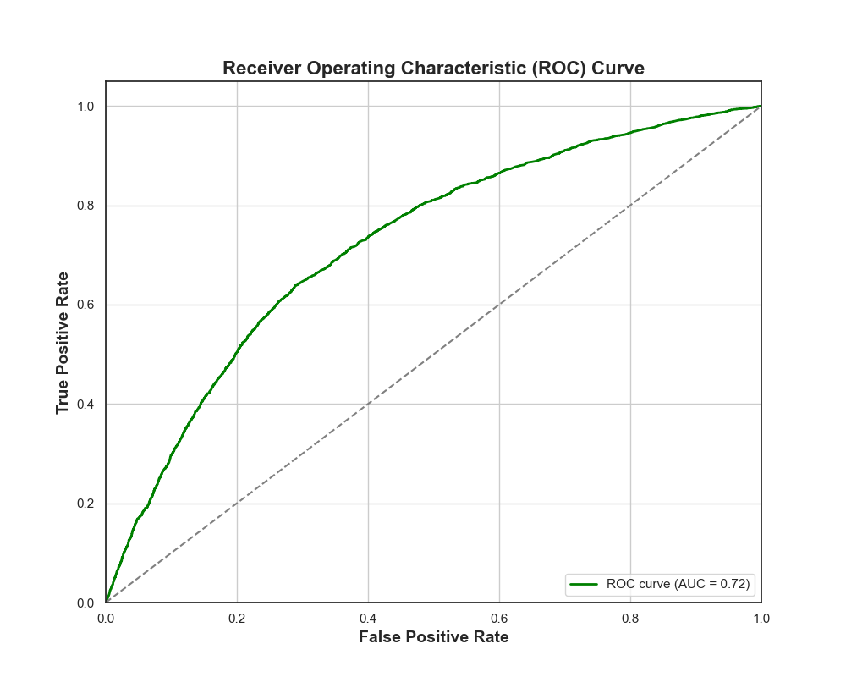
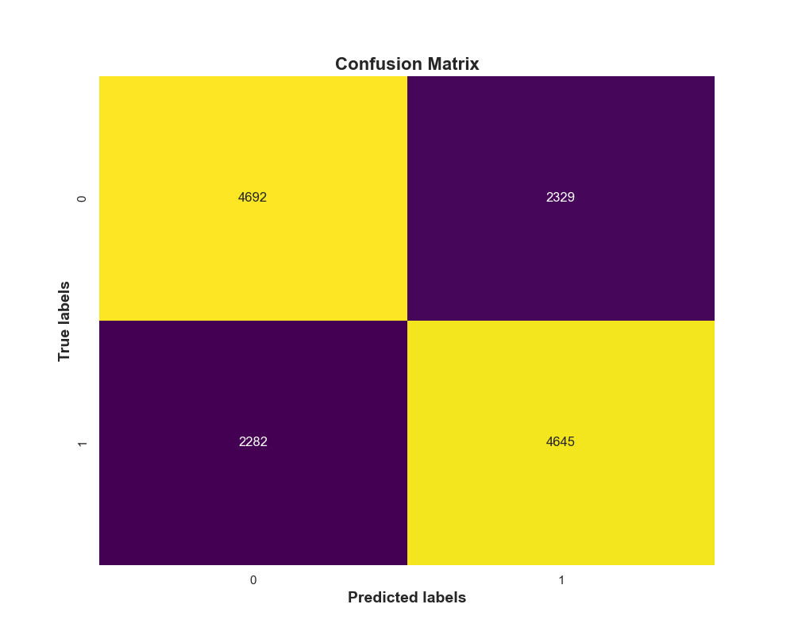
​ROC Curve
Confusion Matrix

Slide 14
Analysis and Insights (Model Explainers)​
1
ROC Curve
2
Confusion Matrix
Graph showing true positive rate against false positive rate.
Matrix showing the counts of true positive, false positive, true negative, and false negative predictions made by a classification model.
3
Feature Importance
4
Permutation Analysis​
Ranking or score indicating the relative importance of features in influencing model predictions.
Technique evaluating feature importance by randomly shuffling feature values to measure their impact on model performance.

Slide 15
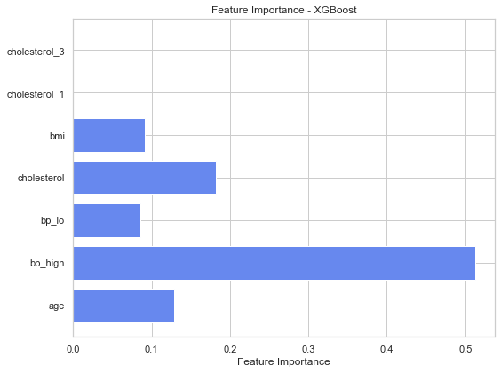
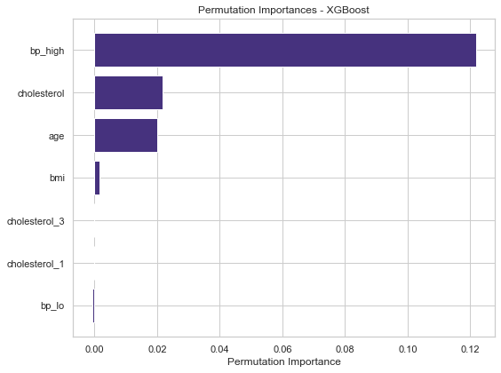
​Feature Important Analysis
Permutation Analysis

Slide 16

Dashboard
Streamlit (Python Library)
Python Powered interactivity to make web app
Easy to deploy ML models
https://openmind.streamlit.app

Slide 17
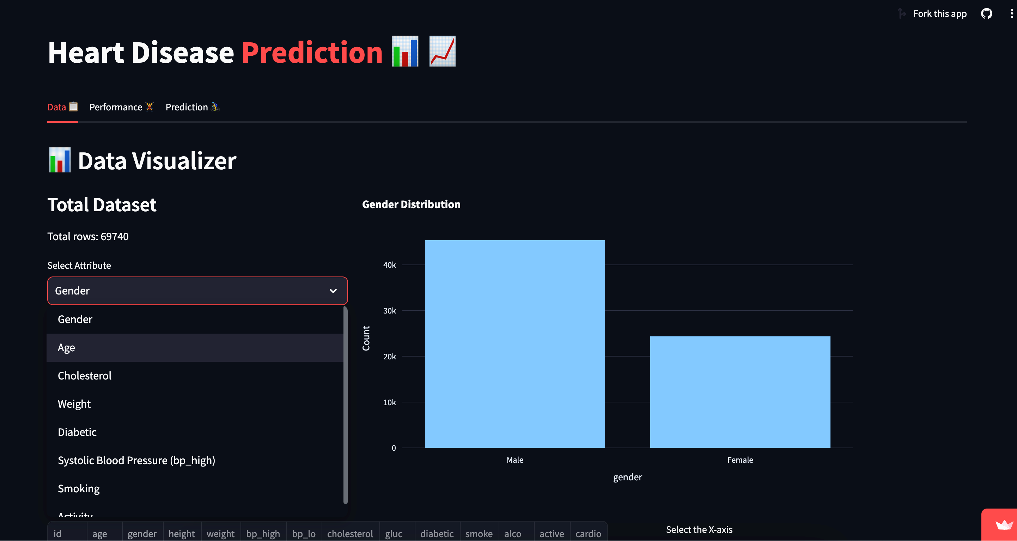
Data Visualization​

Slide 18
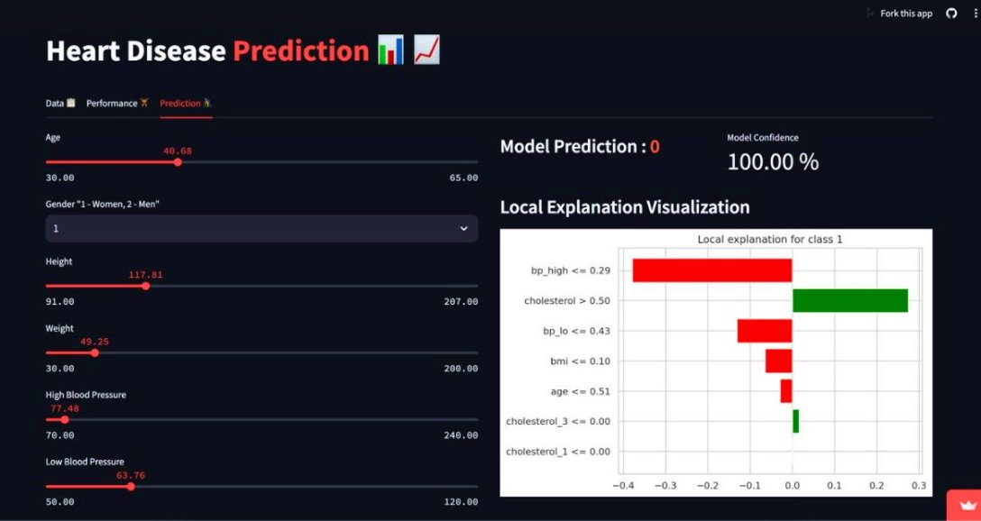
Predictions

Slide 19
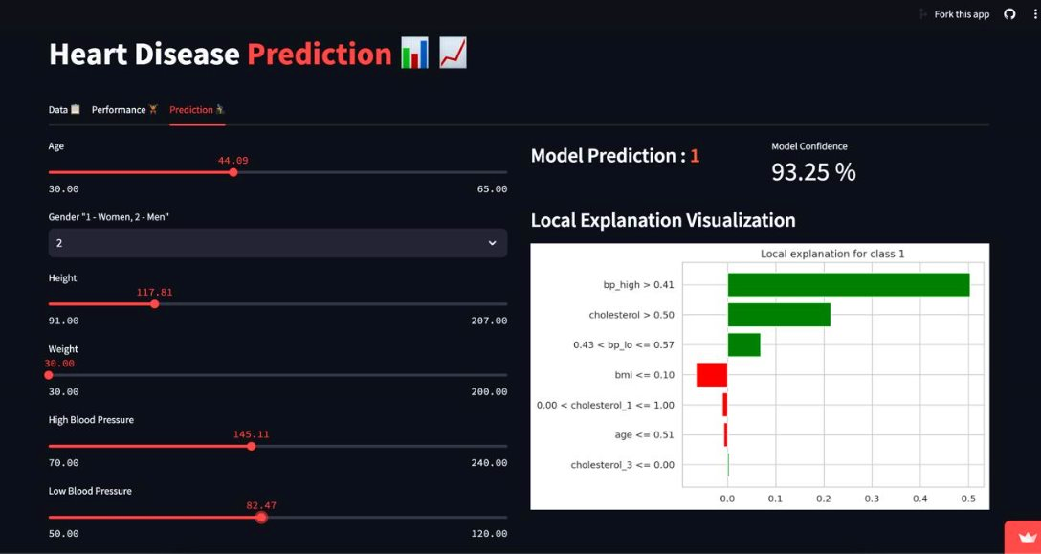

Slide 20
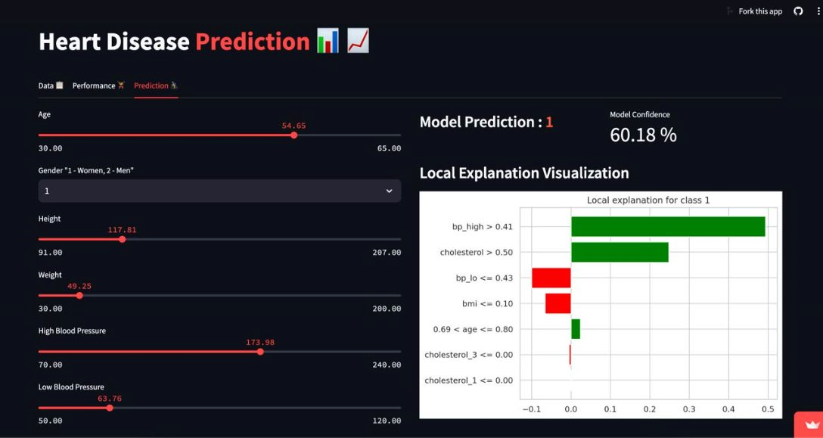

Slide 21
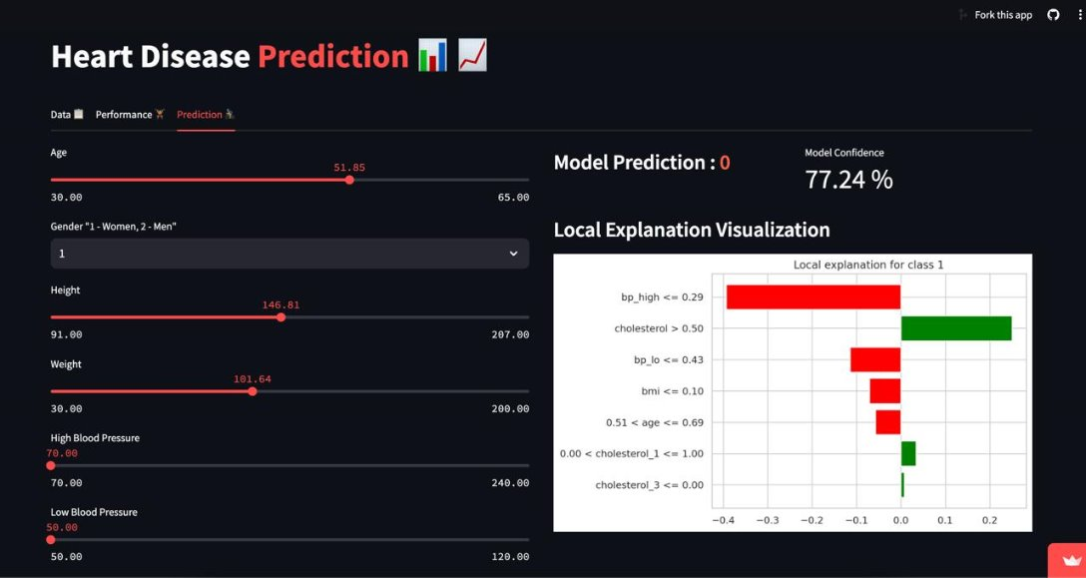

Slide 22
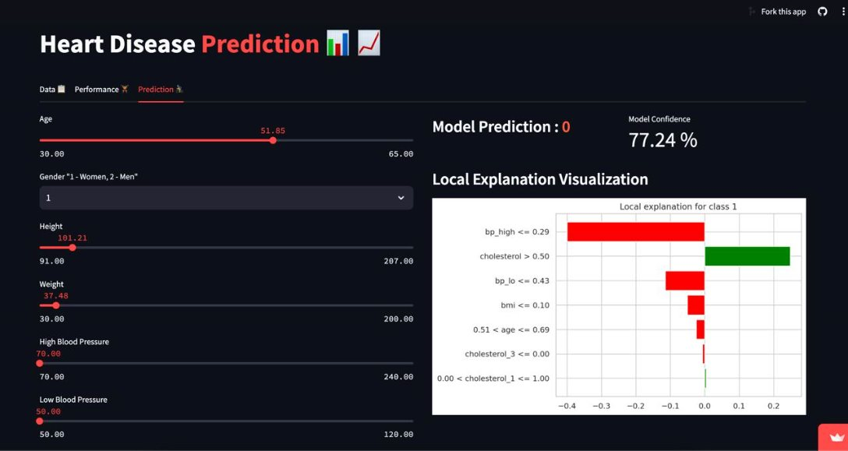

Slide 23

Timely Interventions​
Conclusion and Future Directions
Early Health Preventions
Early prediction of cardiovascular diseases allows for timely interventions
Personalized Care
Predictive models can help identify high-risk individuals, enabling personalized treatment plans
Cost Savings
Early prevention can lead to significant cost savings by reducing the need for long-term hospitalization

Slide 24

Open for Collaboration🤩
https://github.com/OpenMinds-LCIT/cardiovascular-disease-prediction
https://openmind.streamlit.app/

Slide 25


